Slide 1
Communication Fundamentals Importance And Phases
SlideMake.com

Slide 2
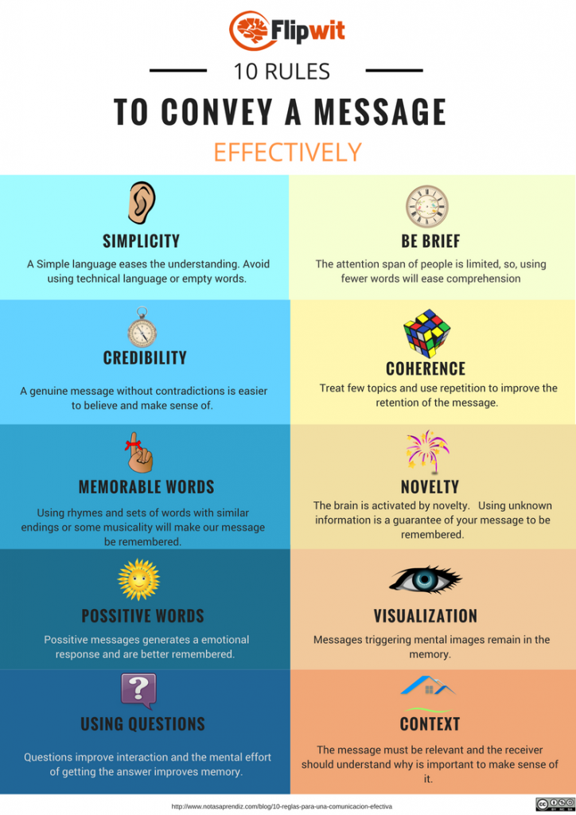
Introduction to Communication Fundamentals
Communication is the process through which we convey information, thoughts, and feelings.
It encompasses verbal, non-verbal, written, and visual forms.
Understanding its fundamentals is vital for effective interaction in personal and professional settings.
Notes:
Image source: https://www.flipwit.com

Slide 3

Importance of Communication
Effective communication fosters better relationships and understanding among individuals.
It plays a crucial role in teamwork and collaboration in various environments.
Strong communication skills can enhance both personal and professional growth.
Notes:
Image source: https://www.atap-us.org

Slide 4
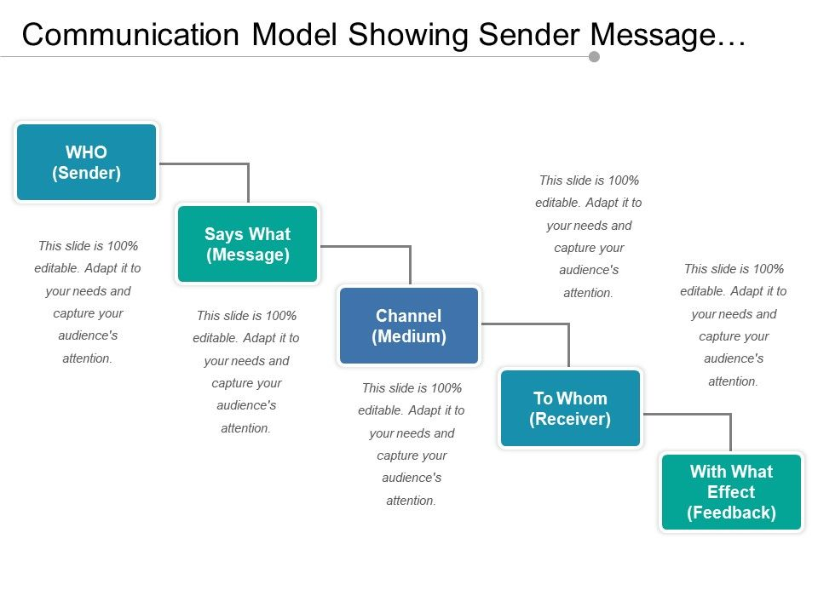
Key Components of Communication
The key components include the sender, message, medium, receiver, and feedback.
Each component plays a critical role in ensuring the message is conveyed accurately.
Understanding these components helps to identify barriers to effective communication.
Notes:
Image source: https://www.slideteam.net

Slide 5
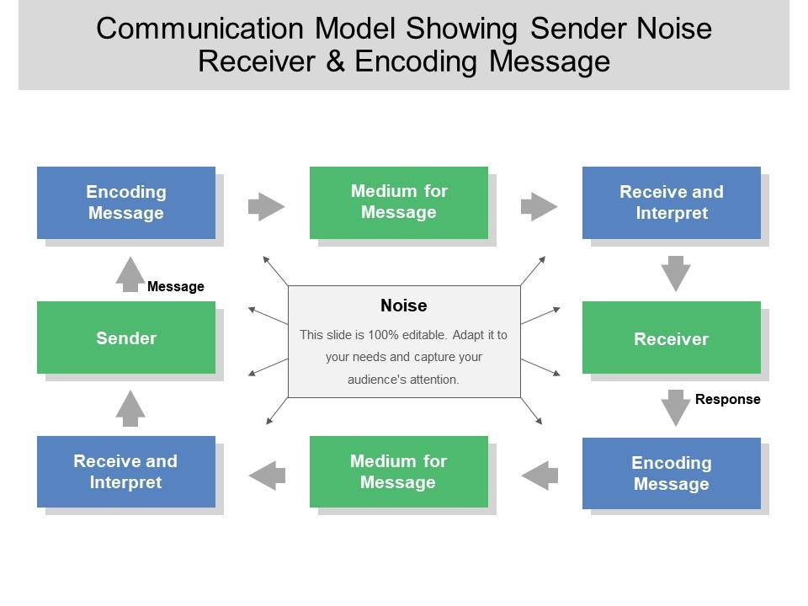
The Communication Process
The communication process is a cyclical model that involves the sender encoding the message.
The message is then transmitted through a chosen medium to the receiver.
Finally, feedback is collected to assess the effectiveness of the communication.
Notes:
Image source: https://www.slideteam.net

Slide 6
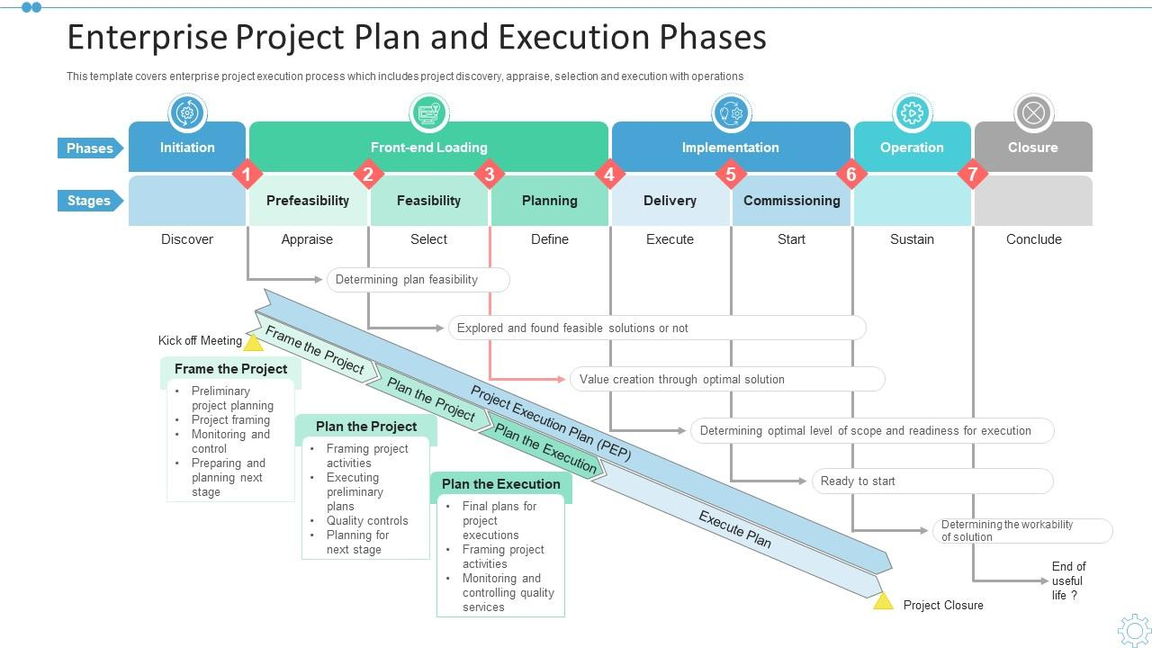
Phases of Communication
The communication process can be broken down into distinct phases: Planning, Execution, and Evaluation.
Each phase requires specific skills and strategies to ensure successful communication.
Understanding these phases can lead to more effective and purposeful interactions.
Notes:
Image source: https://www.slideteam.net

Slide 7
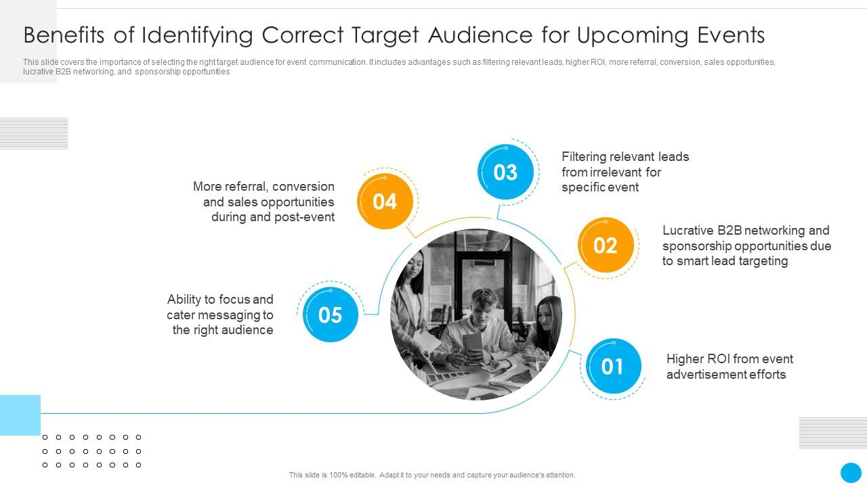
Phase 1: Planning
Planning involves identifying the purpose of the communication and the target audience.
During this phase, the sender must decide on the key messages to convey.
Effective planning establishes a clear framework for the subsequent phases.
Notes:
Image source: https://www.slideteam.net

Slide 8
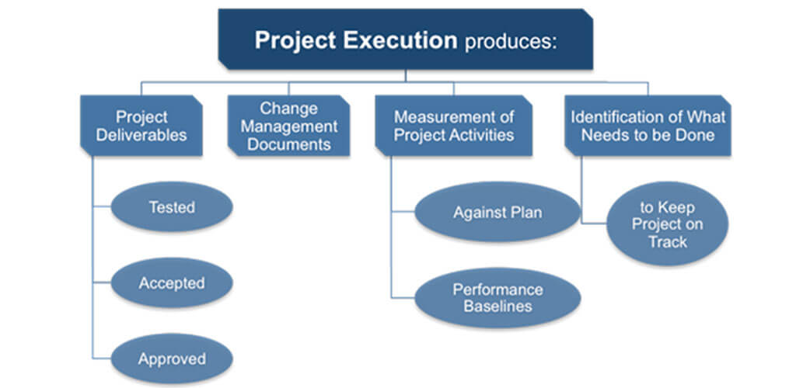
Phase 2: Execution
Execution is the phase where the planned message is delivered through the chosen medium.
It requires attention to tone, clarity, and engagement to ensure the message resonates.
Successful execution also involves active listening and responsiveness from the receiver.
Notes:
Image source: https://aprika.com

Slide 9

Phase 3: Evaluation
Evaluation involves gathering feedback to assess the effectiveness of the communication.
This phase helps identify any misunderstandings and areas for improvement.
Continuous evaluation fosters a culture of open communication and growth.
Notes:
Image source: https://c8.alamy.com

Slide 10
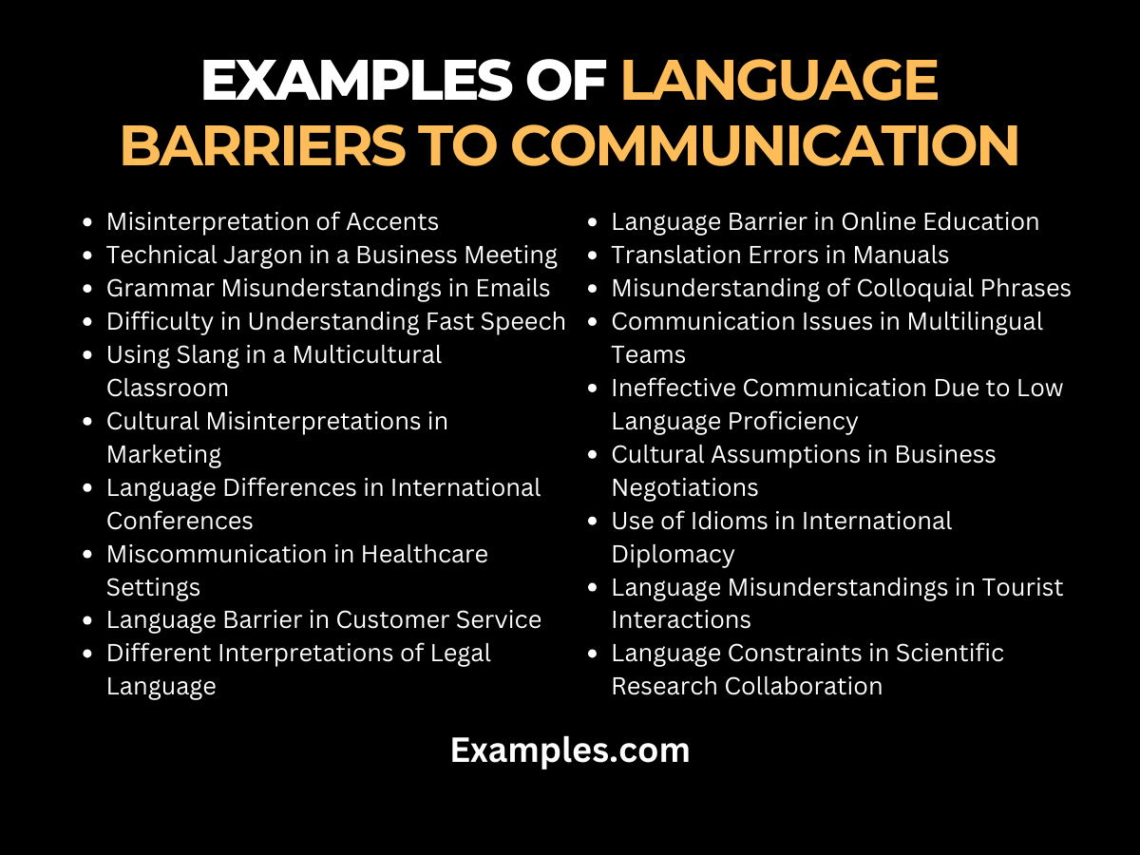
Barriers to Effective Communication
Common barriers include language differences, cultural misunderstandings, and emotional biases.
Identifying these barriers is essential for overcoming challenges in communication.
Strategies to mitigate these barriers involve active listening and empathy.
Notes:
Image source: https://images.examples.com

Slide 11

Conclusion
Mastering communication fundamentals is essential for success in all areas of life.
Understanding the importance and phases of communication enhances interpersonal skills.
By continually refining communication practices, individuals can improve their interactions significantly.
Notes:
Image source: https://www.talentproindia.com

Slide 12
References
Adler, R. B., Rosenfeld, L. B., & Proctor, R. F. (2016). Interplay: The Process of Interpersonal Communication. Oxford University Press.
Beebe, S. A., Beebe, S. J., & Ivy, D. K. (2016). Communication Principles for a Lifetime. Pearson.
Wood, J. T. (2016). Communication Mosaics: An Introduction to the Field of Communication. Cengage Learning.
Feel free to customize or expand upon any slides as needed!

